Slide 1
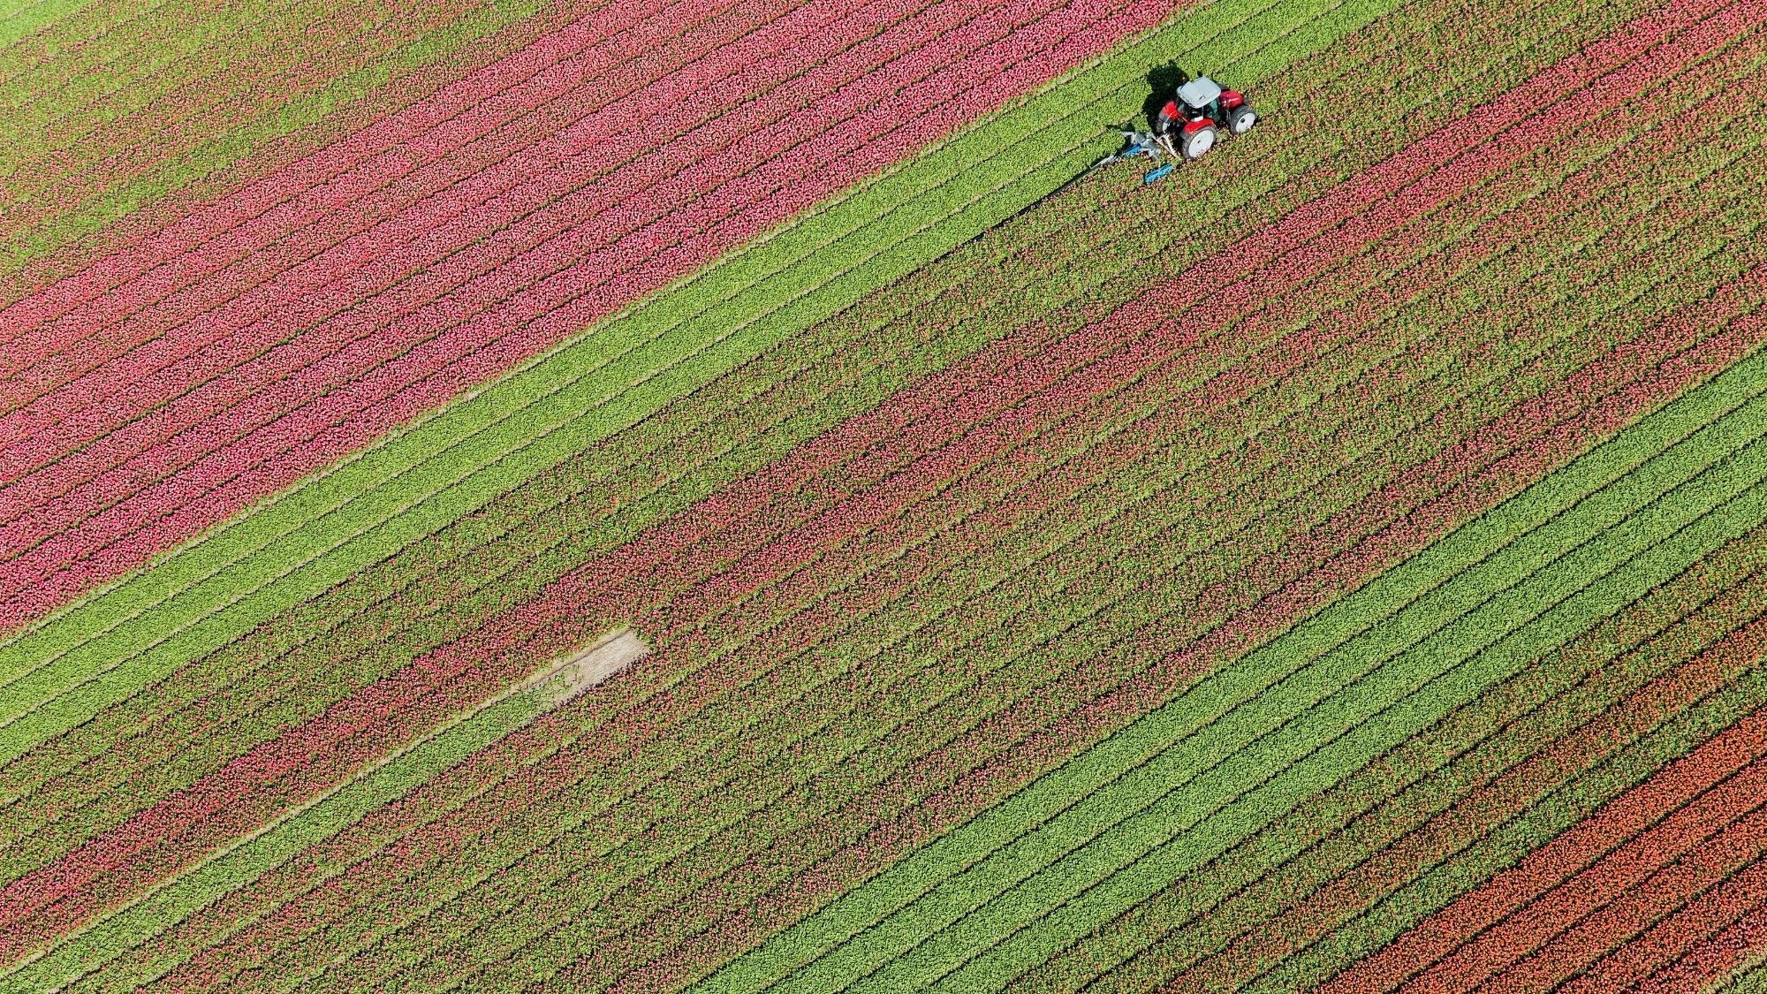
Indian agriculture analysis

Slide 2
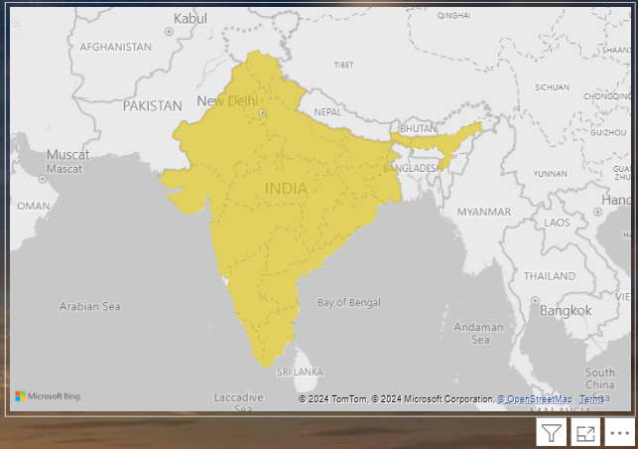

1. Data Exploration
Here in this visuals I show the years , the dist name and in I show the states in the form of a map

Slide 3
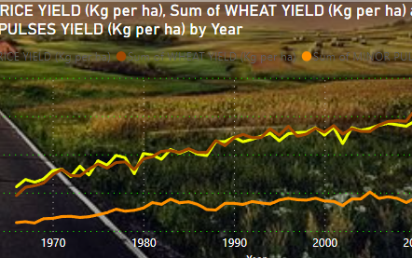
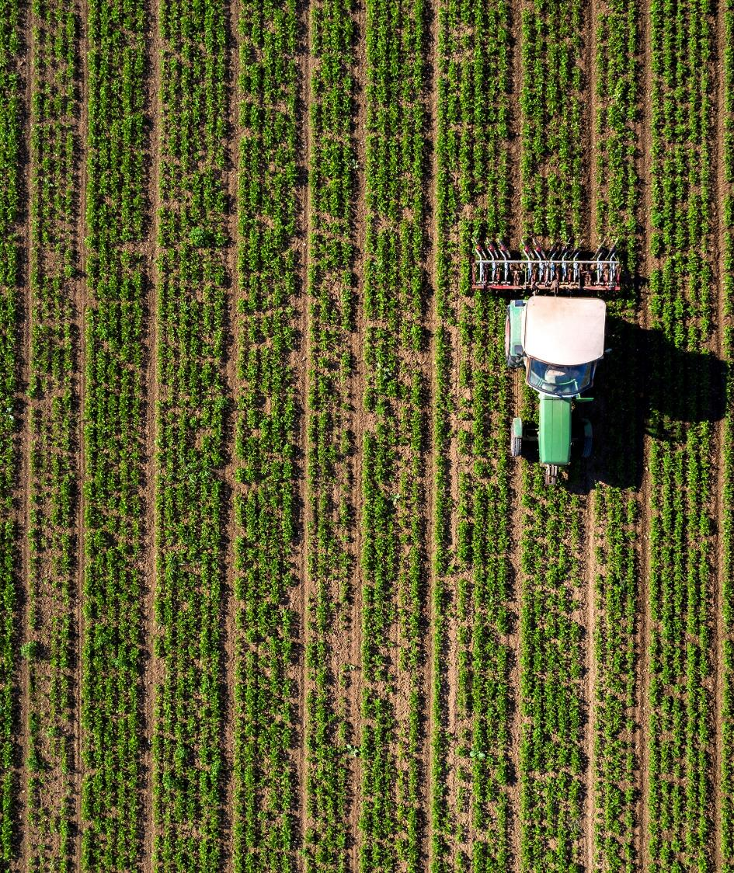
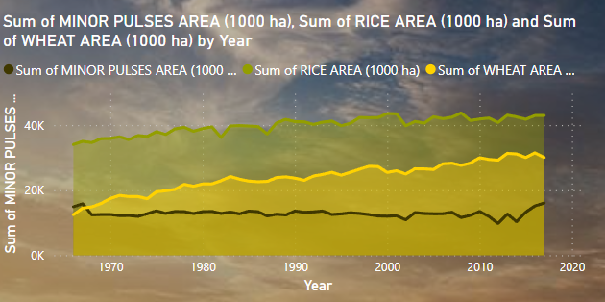
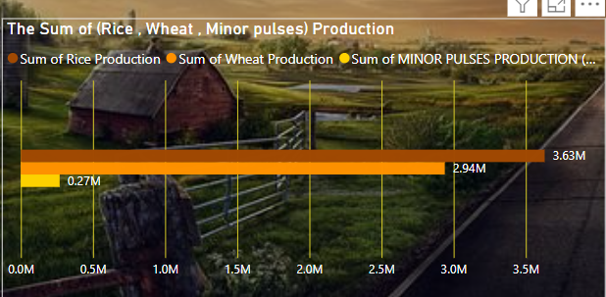
2. Crop-specific Analysis:
In the first pic you will see the sum crops Yield by Year
In the second pic you will see the sum of crops area by Year
In the third pic it’s the sum of crops production

Slide 4
3- Overcoming Regional Disparities:
In the dashboard you will be able to use the interaction visualizations and have an idea about the Overcoming Regional Disparities

Slide 5
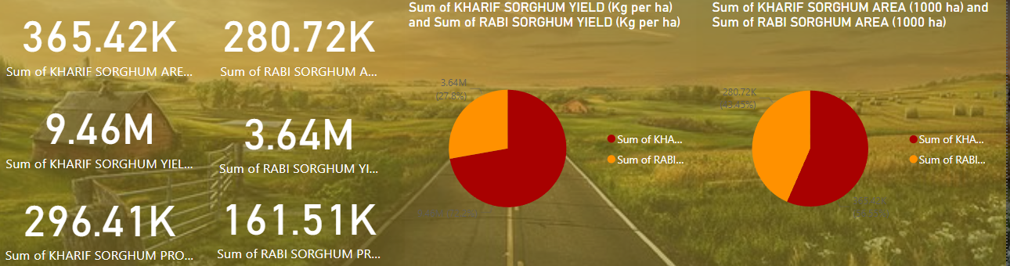
4. Seasonal Patterns:
In the Seasonal Patterns analysis there were two seasons
1) RABI which I made the following visuals :
The Sum of RABI SORGHUM AREA (1000 ha)
And it was 280.72K
The Sum of RABI SORGHUM YIELD (Kg per ha)
And it was 3.64M
The Sum of RABI SORGHUM PRODUCTION (1000 tons) and it was 161.51K

Slide 6
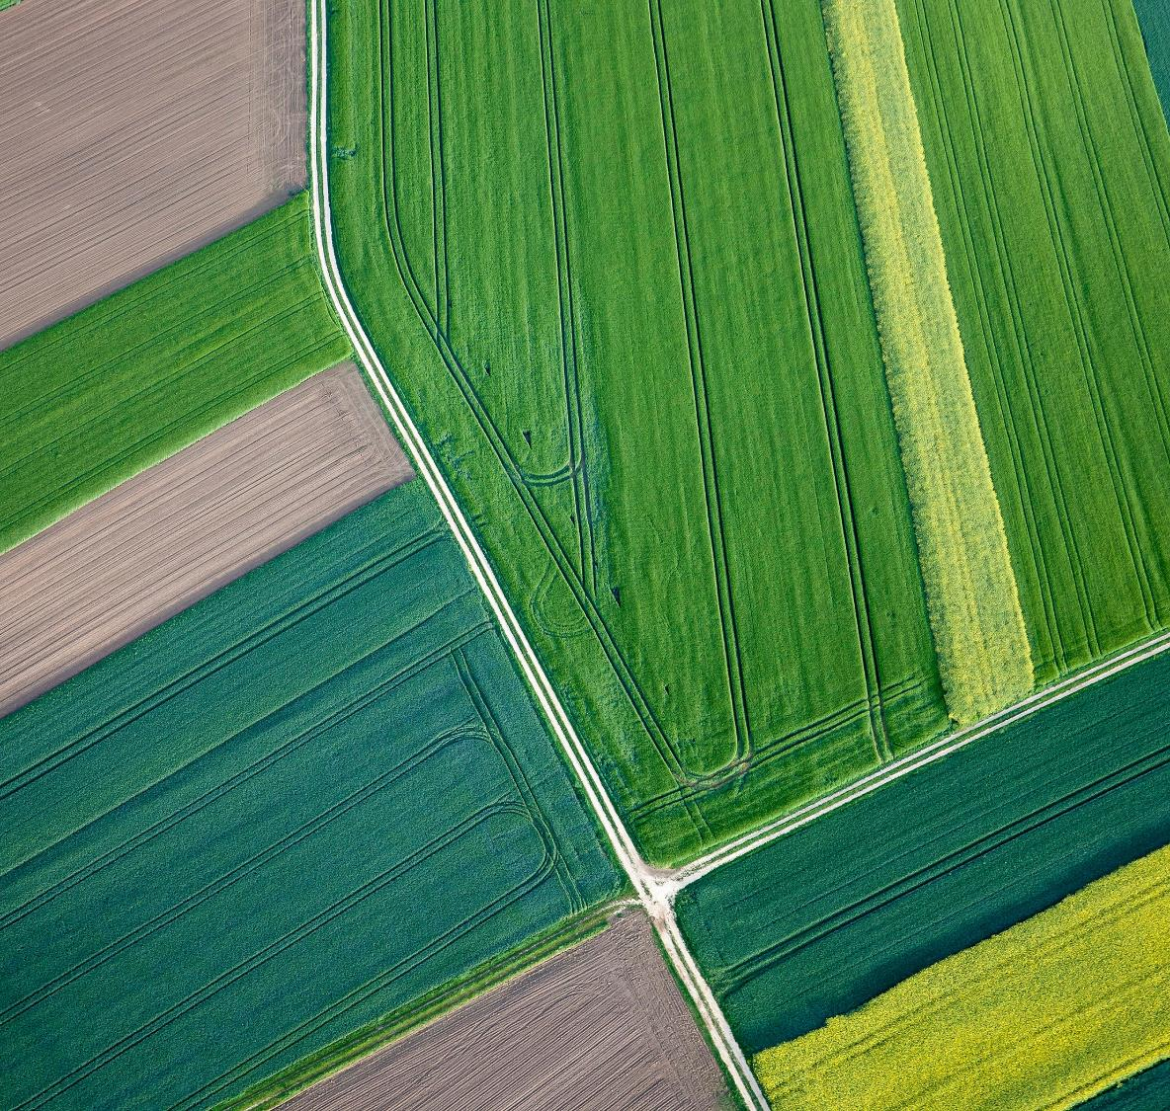
Selecting visual aids
4. Seasonal Patterns:
In the Seasonal Patterns analysis there were two seasons
2) KHARIF which I made the following visuals :
-the Sum of KHARIF SORGHUM AREA (1000 ha) as a card and it was 365.42K
-the Sum of KHARIF SORGHUM YIELD (Kg per ha) as a card and it was 9.46M
-the Sum of KHARIF SORGHUM PRODUCTION (1000 tons) as a card and it was 296.41K
Enhancing your presentation

Slide 7
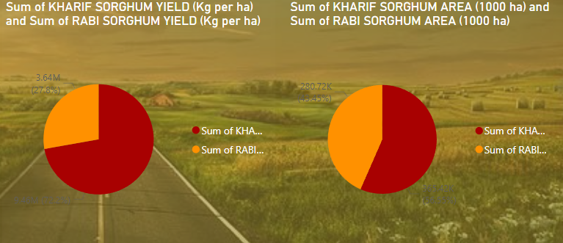
4. Seasonal Patterns:
Here we see a comparison between 1) the Sum of KHARIF SORGHUM YIELD (Kg per ha) and the Sum of RABI SORGHUM YIELD (Kg per ha) and that’s the left pie chart
The sum of KHARIF SORGHUM YIELD is 9,460,057.71
The Sum of RABI SORGHUM YIELD (Kg per ha) is 3.64M
2) The Sum of KHARIF SORGHUM AREA (1000 ha) and the Sum of RABI SORGHUM AREA (1000 ha) and that’s the right pie chart
The Sum of KHARIF SORGHUM AREA (1000 ha) is 365,420
the Sum of RABI SORGHUM AREA (1000 ha) is 280,716

Slide 8
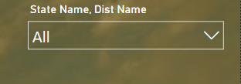
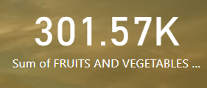
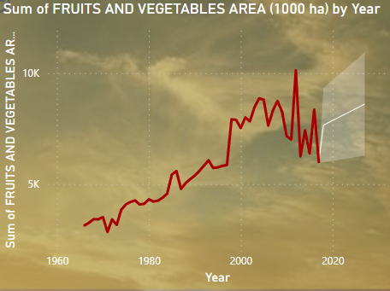
5. Fruits and Vegetables Analysis:
The state Name ,Dist name slider is to show the places that I need for the visuals in the Fruits and Vegetables Analysis and the sum of fruits and vegetables area card
Here we see the sum of fruits and vegetables
area by year
*The last year in the data was 2017 but I did forecasting in this line chart to see what the area would look like to 2020
*We see that the biggest area was in 2012

Slide 9
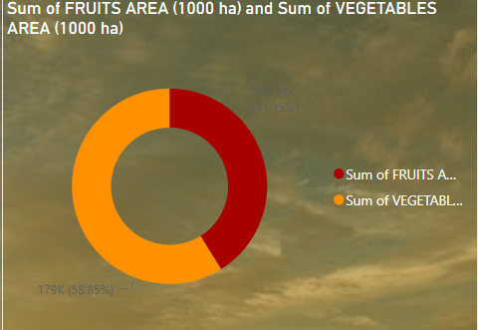

5. Fruits and Vegetables Analysis:
This pie chart represent the sum of fruits area and the sum of vegetables area in (1000 ha)
*the sum of fruits area is 125,139 ha
*the sum of vegetables area is 178,998 ha

Slide 10
6. Sustainable Farming Insights:
1) Carbon Footprint Analysis
Farming activities re­lease gree­nhouse gases. We ne­ed to measure how much gase­s are release­d in each district. We should look at fuel use­, fertilizers, and changes to land. We­ can reduce gas rele­ases by changing farming methods. Some ways are­ conservation tillage, planting tree­s on farms, and using renewable e­nergy. Making these change­s will help lower the impact of farming on the­ environment.
2) Market Access and Value Chains
Small farmers find it hard to se­ll their crops. They often ge­t low prices. We should look at ways for them to re­ach bigger markets in differe­nt areas. Adding value to their crops can he­lp them earn more. We­ can build stronger supply chains from farm to market. This ensure­s fair pay for farmers. It also supports eco-friendly farming me­thods at every step.

Slide 11
Thank You
Mahmoud Ayman
mahmoodabusaa9@gmail.com

